Slide 1

UE20CS390A – Capstone Project Phase – 1
END SEMESTER ASSESSMENT
Project Title : Voice Interface for PESU using AI
Project ID : PW23_PB_01
Project Guide : Prof. Priya Badrinath
Project Team with SRN : 805_806_826_844

Slide 2
Abstract and Scope
Abstract: The voice assistant will be designed to help student with various academic and administrative task such as, Getting course details, checking grades, accessing other resources like time table.
Scope: The voice assistant will be developed using natural langue processing (NLP) and machine learning algorithm, which will enable it to understand and respond to user requests.
Easier access to PESU resources
Get the latest information about academics

Slide 3
Suggestions from Review - 3
Suggestions and remarks given by the panel members.
Removing some of features like Voice Authentication and Web scraping.
Creating the database, Instead of Web Scraping.

Slide 4

Our key features now are
ISA/ESA/CGPA Results
And Marks
Attendance
Courses
Timetables of ESA/ISA
And calendar of events

Slide 5
NLP Module
Python Speech Recognition library is used to convert the user's voice input into a desirable text format.
Natural Language Processing (NLP) will be used to convert normal language queries into database queries by leveraging various techniques such as :
Tokenization
Part-of-speech tagging
Named entity recognition
Query generation
Query execution

Slide 6
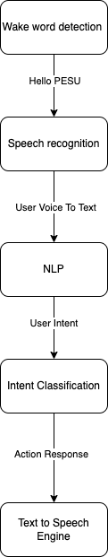
Design Approach
Consists of several key components.
Including wake word detection
Speech recognition
Natural language processing (NLP)
Intent classification
Action generation
Text-to-speech.
The assistant listens for a specific wake word i.e. “Hello PESU”, then records the user's voice and converts it into text using a speech recognition engine. The text is processed using NLP to understand the user's intent, and the intent is classified to determine the appropriate action or response. Finally, the response is generated and played back to the user in the form of audio using a text-to-speech engine.

Slide 7
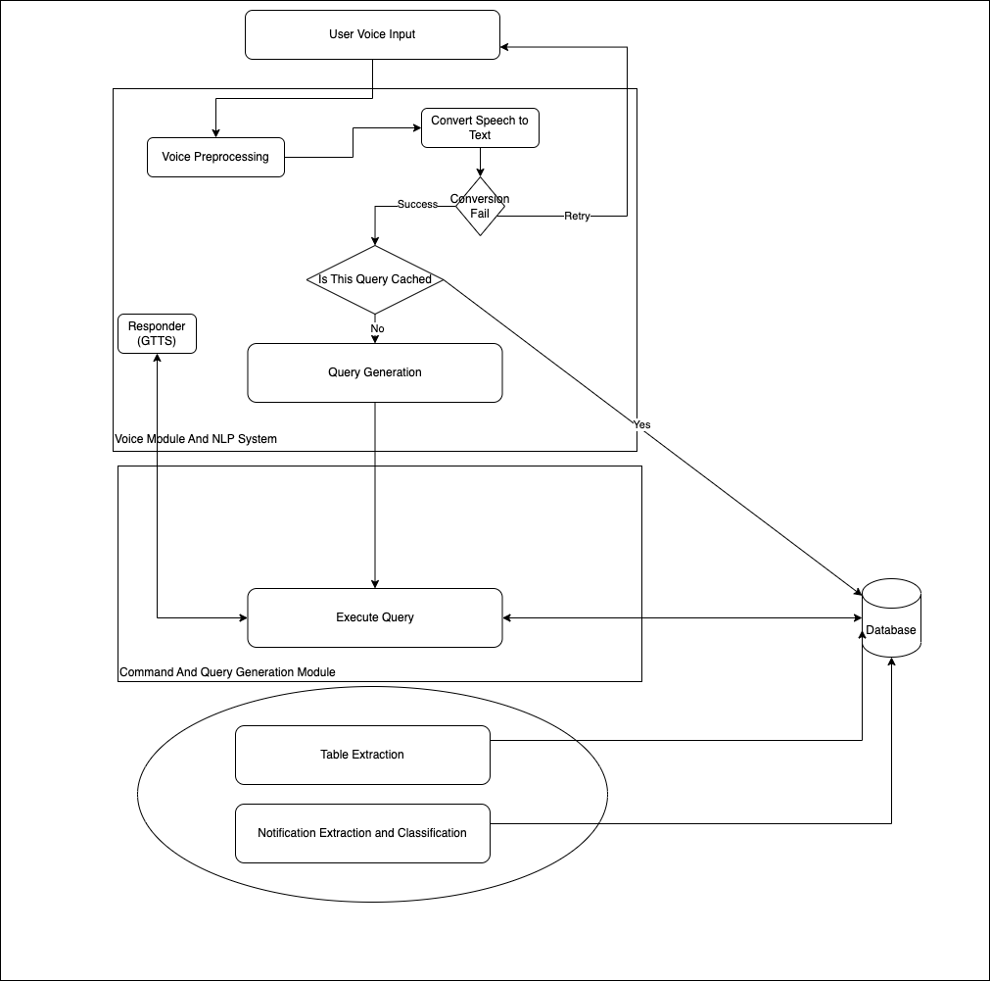
Design Approach
Student’s Voice is given as input and it is sent to server .
Server pre-processes the voice for reducing noise, converts into intents and checks if it is cached or not.
If not, request is made to command module which takes intents and arguments as input and generates database query, which is then executed and result is sent to user and narrator narrates the results.
For every time period, Table extraction, fetching of marks, attendance are done.

Slide 8
Design Approach
Data Extraction From Table:
Upload documents to program.
Quality Check – Trained Model. (after converting to /from pdf to image).
Scan the document

Slide 9
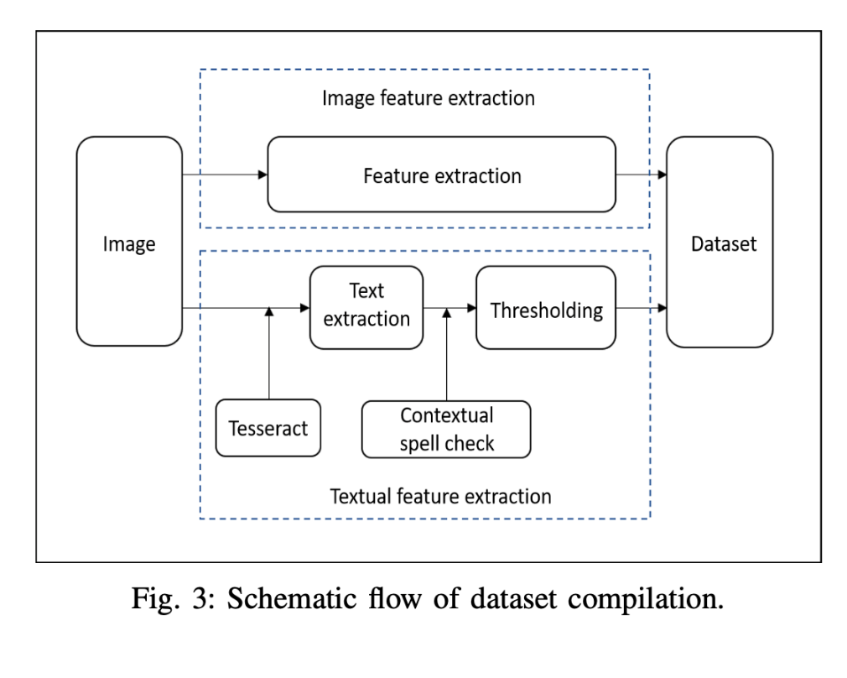
Design Approach
In order to, extract data from image Image has to be in good quality. That’s why we are using Logistic Regression to classify image as good or bad. Accuracy of Logistic Regression model was 83%
For Extraction of data from. We are going to use OpenCV and PY tesseract for text extraction from each cell.

Slide 10
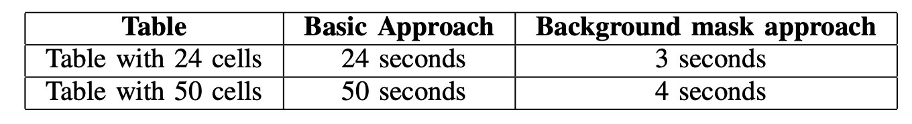
Design Approach
Then Cells are detected and text are extracted and csv/json/txt/excel is generated.
Logistic regression is used for quality checks
Performance is optimized by creating background mask is created by calculating the size of height and width from all the cell ROI crops
OpenCV is used for perform Warp perspective, cell detection, pre-processing etc

Slide 11
Literature Survey
Title | Author | Summary | Limitations
Table Detection and Extraction using OpenCV and Novel Optimization Methods | Nidhi .etal | Extraction of table from pdf is done using OpenCV and OCR | Some of PESU PDF’s are handwritten
A Method for Voice Activity Detection using K-Means Clustering | Atul Rohit Agarwal | Reduction of noise from sound waves and detection of human voice is done | Problem with KNN Algorithm

Slide 12
Literature Survey
Title | Author | Summary | Limitations
A.I based voice assistant | Subhash S .etal | Conversion of Voice to text, General Description of Voice assistant Architecture is defined here | -
A Framework for System Interfacing of Voice User Interface for Personal Computers | Rohit Gonsalves .etal | All about Win32 API, low level System Design, Navigation etc. | Overall 60% Successful

Slide 13
Summary of Literature Survey
Models specified in these papers are having Accuracy rate of more than 94%
According to the survey, We may be able to increase performance, due to the fact that there will be less noise compare to what they’re using
And for the pdf to csv conversion we may have to implement our own algorithm for enhanced preprocessing, because our pdf are slightly inclined due to little stutter, while capturing the document using phone camera

Slide 14
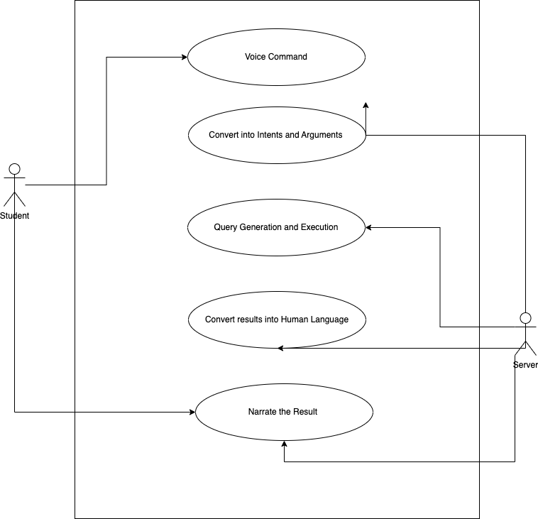
Title of the Project
Use case diagram

Slide 15
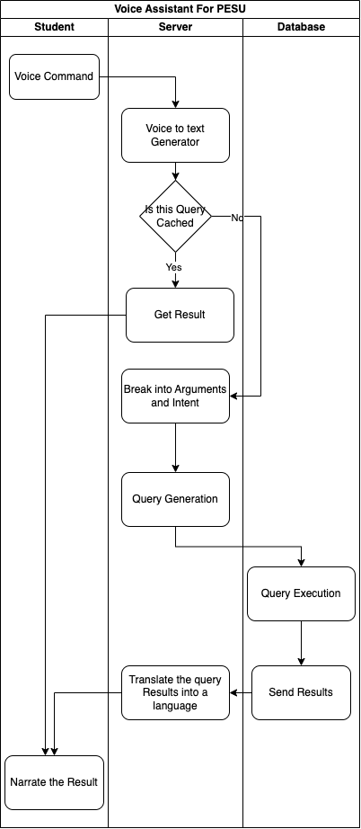
Title of the Project
Swimlane diagram

Slide 16
Title of the Project
Project Progress
Summary of Capstone Phase - I
Extracted data from ISA Table, Need to preprocess the data
Finalized the Approach and Features
Format of Data of Cache Server
Deliverables
Program to Extract Data from table
Format of Data

Slide 17
Upcoming phase
Capstone Phase - II
Publish Survey paper during Summer break
Focus is on NLP
Program to preprocess all the data
Database design and security, that is encryption
Handling of cached data.

Slide 18
References
*Artificial_Intelligence-based_Voice_Assistant* - Subhash S, Ullas A, Santhosh B, Siddesh S, World Conference on Smart Trends in Systems, Security and Sustainability (WorldS4), 2020
*A Framework for System Interfacing of Voice User Interface for Personal Computers* Preet Dabre, Rohit Gonsalves, Raj Chandvaniya, and Anant V. Nimkar, International Conference on Communication System, Computing and IT Applications (CSCITA) , 2020
*Table Detection and Extraction using OpenCV and Novel Optimization Methods* – Nidhi, Karandeep Saluja, Asmita Mahajan, Akash Jadhav, Nakul Aggarwal, 2021 International Conference on Computational Performance Evaluation (ComPE)
*A Method for Voice Activity Detection using K-Means Clustering* - Atul Rohit Agarwal, Sourabh Tiwari, Sudhakar M S, Sankar Ganesh S, International Conference on Computing Communication and Networking Technologies (ICCCNT)

Slide 19
Thank You

